Slide 1
Domain Dependent Query Reformulation for Web Search
Date : 2013/06/17
Author : Van Dang, Giridhar Kumaran, Adam Troy
Source : CIKM’12
Advisor : Dr. Jia-Ling Koh
Speaker : Yi-Hsuan Yeh

Slide 2
Outline
Introduction
Method
Experiment
Conclusions

Slide 3
Introduction (1/5)
Query reformulation techniques aim to modify user queries to make then more effective for retrieval.
Identify candidate terms that are similar to the words in the query and then expend or substitute the original query terms.

Slide 4
Introduction (2/5)
Existing work :
Spelling correction
Stemming expends query with morphological variants
Look for candidates that are semantically related to the query terms
However, none of the techniques consider the task as domain dependent.

Slide 5
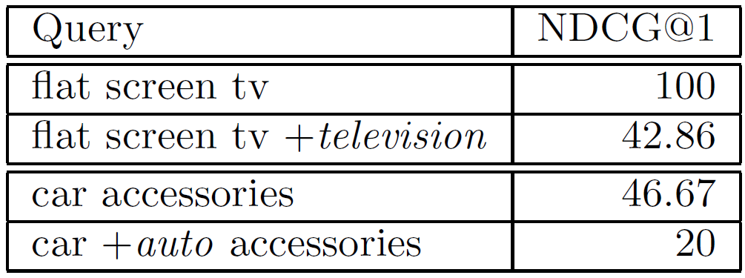
Introduction (3/5) - Motivation
In the domain of commerce queries, however, expanding the query from ‘flat screen tv’ to ‘flat screen tv television’ drastically hurts NDCG.

Slide 6
Introduction (4/5) - Goal
Provide different candidate terms for queries in deferent domain.
Build different reformulation systems provide substantially better retrieval effectiveness than having a single system handling all queries.

Slide 7
Introduction (5/5) - Framework
Query logs
Pseudo parallel corpus
Translation model
New queries
Reformulation model
(domain-specific)
Filer out bad candidates
(classifier)

Slide 8
Outline
Introduction
Method
Pseudo parallel corpus
Translation model
Reformulation model
Candidate query generation
Experiment
Conclusions

Slide 9
Pseudo parallel corpus
Parallel pair : <Query, Translation>
Consecutive query pairs
Query and clicked document title
Query suggestion via Random Walk (two)
q1
D1
q2

Slide 10
Translation model (1/3)
Aim to provide multiple semantically related candidates as “translations” for any given query term.
The translation probability indicates similarity between the term and candidate.

Slide 11
Translation model (2/3)
S : source sentence
T : correct translation
a = {a₁, a1, …, a_{m}} : an alignment between S and T
Tr(t_{j} | s_{(aj)}) : translation probability
Expectation Maximization algorithm
Identify the most probable alignments for all parallel pairs.

Slide 12
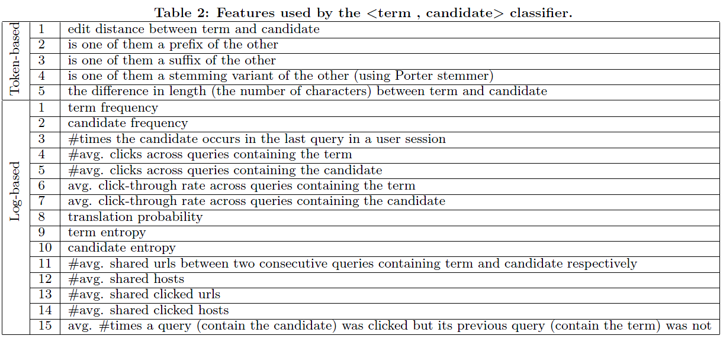
Translation model (3/3) - Enhanced by learning
Train a boosted decision tree classifier which classifies if a <term, candidate> pair is desirable.

Slide 13
Reformulation model (1/4)
Given a query q = w₁, ..., w_{i−1}, w_{i}, w_{i+1}, ..., w_{n} and the candidate s for the query term w_{i}.
The reformulation model determines whether or not to accept this candidate.
Consider：
How similar s is to w_{i}
How fit s is to the context of the query

Slide 14
Reformulation model (2/4)

Slide 15
Reformulation model (3/4)
The probability of seeing w (query term) in the context of s (candidate)
The probability of seeing w in the entire collection
G : L₁, L₂, R₁ , R₂
C(S) : the set of words that occur in the context of s
Collection : all original and “translation” queries

Slide 16
Reformulation model (4/4) - Domain-specific model
smooth
Estimated from the domain specific log
Estimated from the generic log

Slide 17
Candidate queries generation
Each of these candidates s_{ij} for the query term w_{i} is accepted if and only if:
Expend the original queries with these accepted candidates.
θ= 0.9

Slide 18
Outline
Introduction
Method
Experiment
Conclusions

Slide 19
Experiment (1/6)
Query set
Web query log
Health
Commerce
Reformulation approach
Baseline：noalter (without reformulation)
Generic (domain independent)
Health
Commerce
Model parameters
λ= 0.9, β= 0.9 and θ= 0.9.

Slide 20
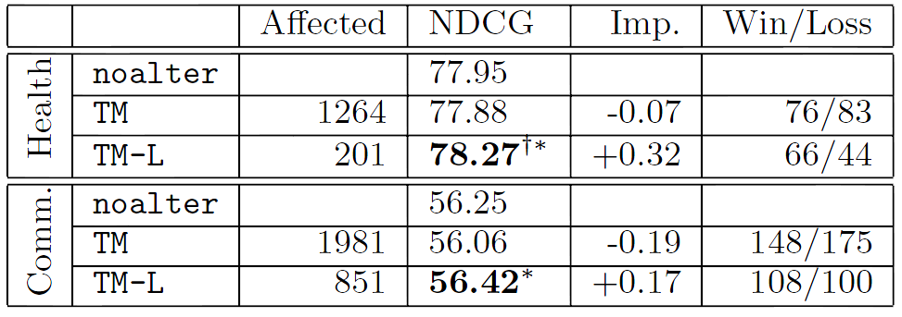
Experiment (2/6) - Transaction model filtering：effectiveness

Slide 21
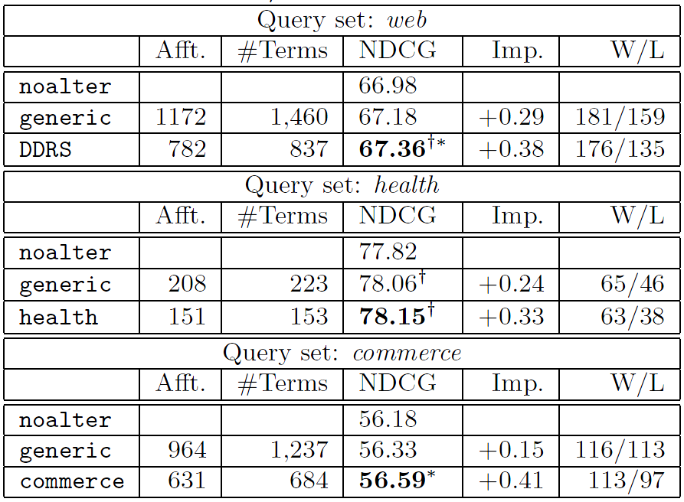
Experiment (3/6) - Generic vs. domain specific

Slide 22
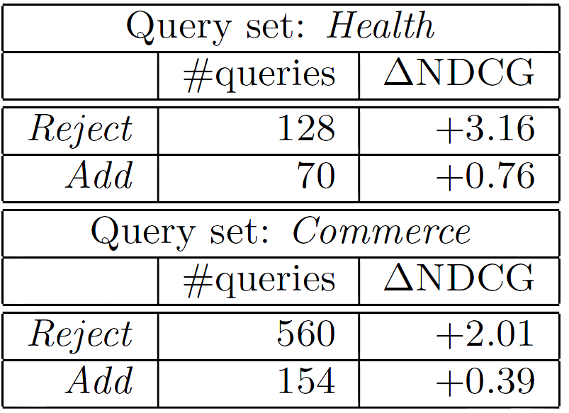
Experiment (4/6) - Reason for improvement
Eliminate ineffective general candidates provided by the generic model. (Reject)
Domain system provide additional domain-specific candidates. (Add)

Slide 23
Experiment (5/6) - Domain-specific training data

Slide 24
Experiment (6/6) - Failure analysis
Domain model misses several good candidates.
Domain system introduce bad candidates that are not provided by the generic system.

Slide 25
Outline
Introduction
Method
Experiment
Conclusions

Slide 26
Conclusions (1/2)
Demonstrate the advantage of domain dependent query reformulation over the domain independent approach.
Using the same reformulation technique, both reformulation systems for the health and commerce domains outperform the generic system that learns from the same log.

Slide 27
Conclusions (2/2) - Future work
Higher-order contextual n-gram models
Consider the relationship among candidates
Train boosted decision tree with various feature

